Slide 1
Lasso/Ridge Regression
Presented by: The Neural Nets
Notes:
Jesse

Slide 2
Presentation Layout
Intro
Lasso vs Ridge
Advantages / Disadvantages
Inner Workings
Dataset examples
Notes:
Jesse

Slide 3
Intro
Lasso and Ridge regression are both used to prevent overfitting (regularization)
Hyperparameter determines size of penalty applied to coefficients
Performance often measured by Mean Squared Error or r2
Similar to Linear Regression, useful to predict quantities (price, MPG, etc)
Notes:
Jesse
Lasso and Ridge regression are two models which use different regularization techniques, L1 regularization and L2 regularization, to prevent the overfitting of data. These build upon the foundation of a basic Linear Regression model, which seeks to predict values by minimizing the Residual Sum of Squares, adding a hyperparameter (lambda, in theory, or alpha in python) which adds a specified penalty to the coefficients associated with each feature in the dataset.
The performance of these models is often measured in Mean Squared Error, as this can generally give a bit clearer of a picture towards it’s accuracy. r2 is not uncommon to use with these, however, and can help in comparing their performance with those used to using a regular Linear Regression model.
Similar to linear regression, these models are useful in predicting quantities, such as prices, number of items, size, area, or miles per gallon.

Slide 4
Advantages
Disadvantages
Reduces the variance (high variance = overfitting)
Lasso → Feature selection and dealing with outliers
Ridge → better model performance since you’re not losing any features
Certain alpha values can lead to bias (underfitting)
Lasso → you have to be careful to not eliminate features (X-values)
Ridge → Doesn’t do well with outliers

Slide 5
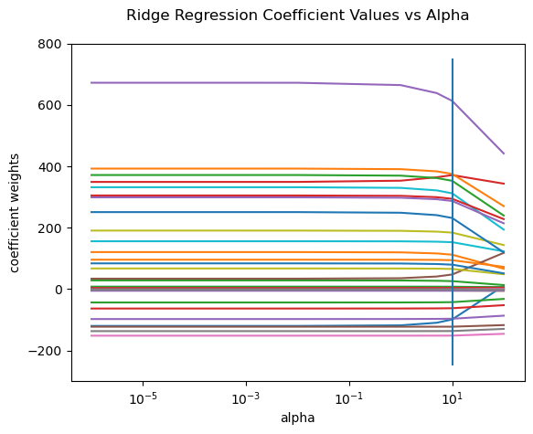
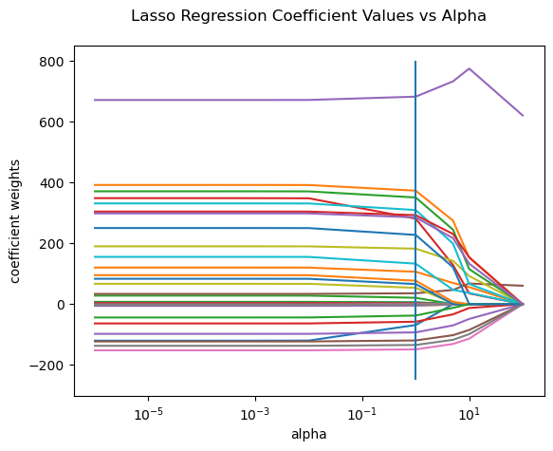
Penalization of the Alpha Parameter

Slide 6
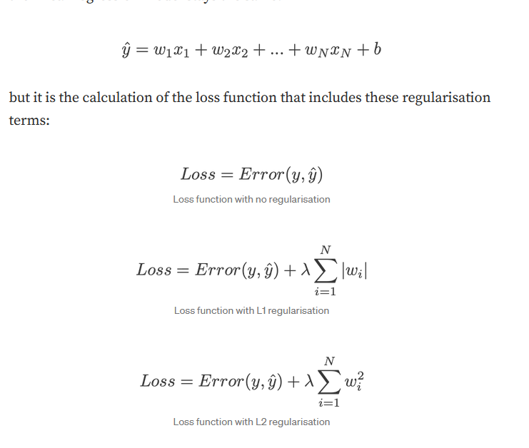
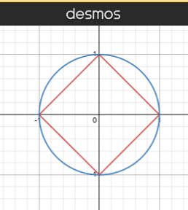
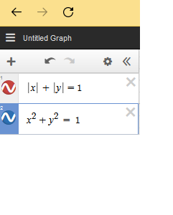
Lasso vs Ridge
Lasso = Linear regression with an L1 penalty
“Diamond method”
Ridge = linear regression with an L2 penalty
“Circle Method”
L2 Regularization (Logistic Regression)
Notes:
Regularisation is a process of introducing additional information in order to prevent overfitting
Gradient descent is simply a method to find the ‘right’ coefficients through iterative updates using the value of the gradient.
Lambda is a hyperparameter = regularization strength (common value 0.01). Higher # = stronger penalty
L1 and L2 regularisation owes its name to L1 and L2 norm of a vector w respectively

Slide 7
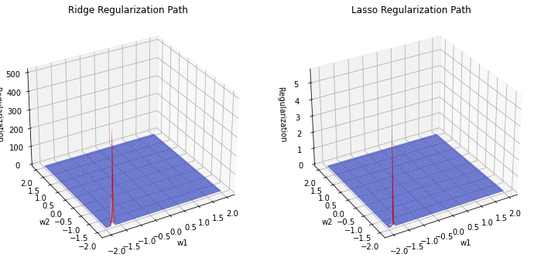
Lasso vs Ridge
https://towardsdatascience.com/intuitions-on-l1-and-l2-regularisation-235f2db4c261

Slide 8
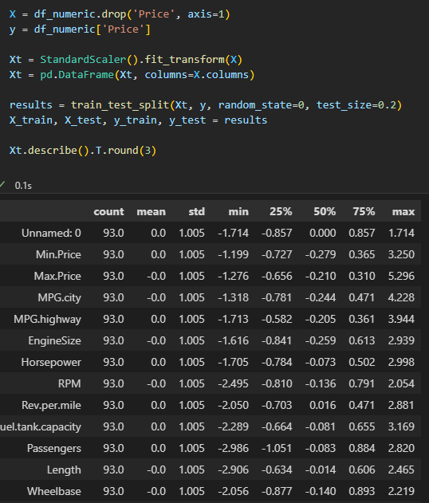
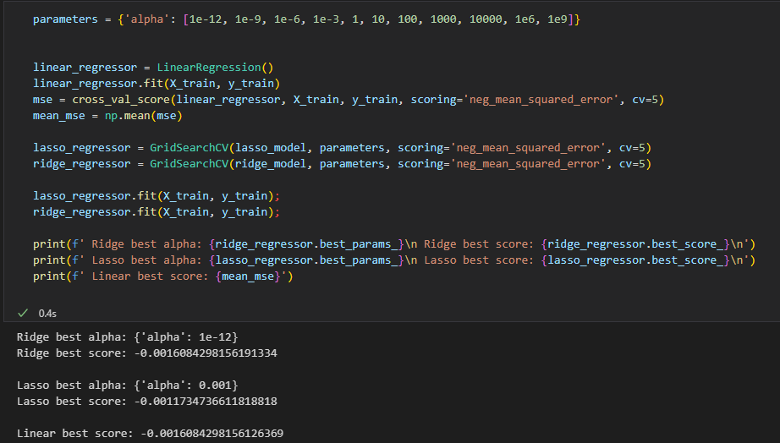
Inner Workings of Lasso/Ridge Regression
Data must be standardized
Cross Validation is important in finding best alpha

Slide 9
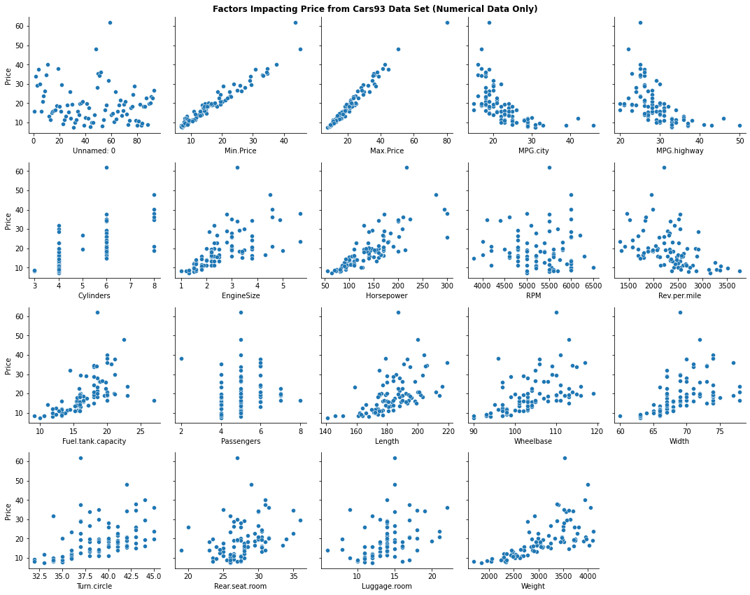
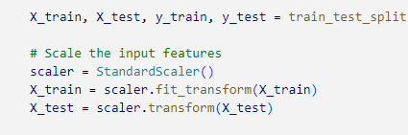
Cars Dataset

Slide 10
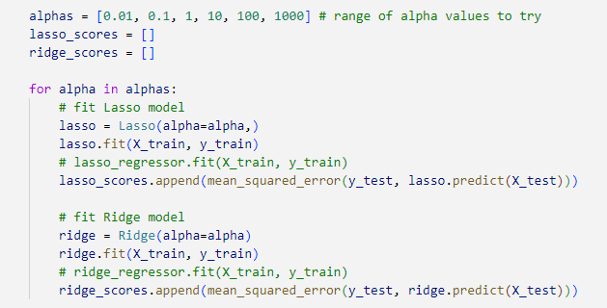
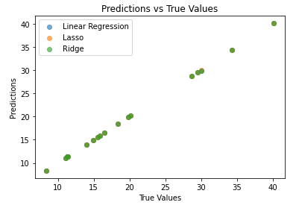
Cars Dataset

Slide 11
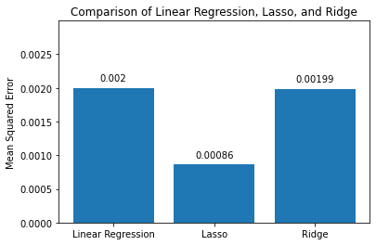
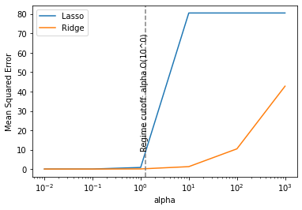
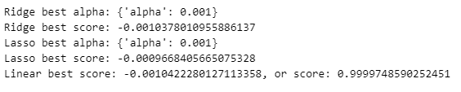
Cars Dataset

Slide 12
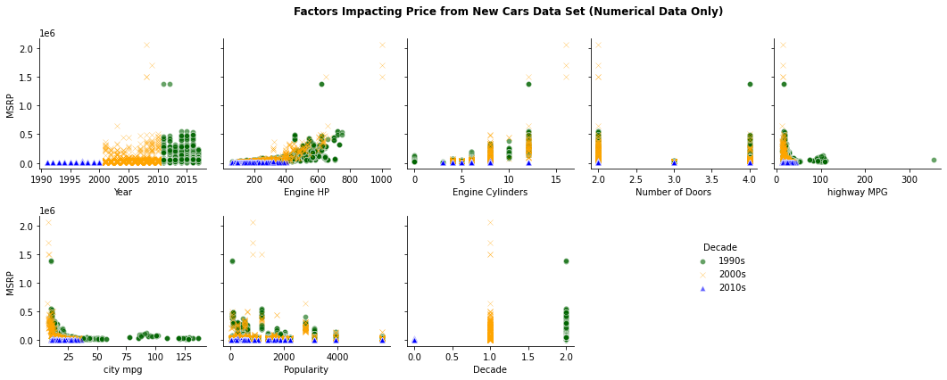
Cars Dataset

Slide 13
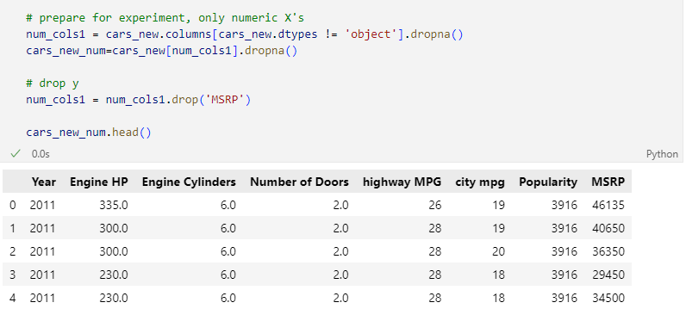
Cars Dataset

Slide 14
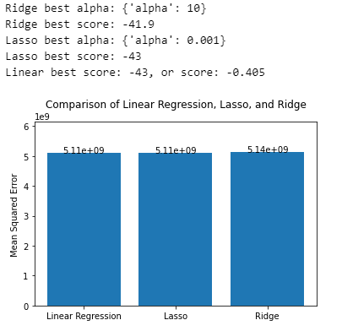
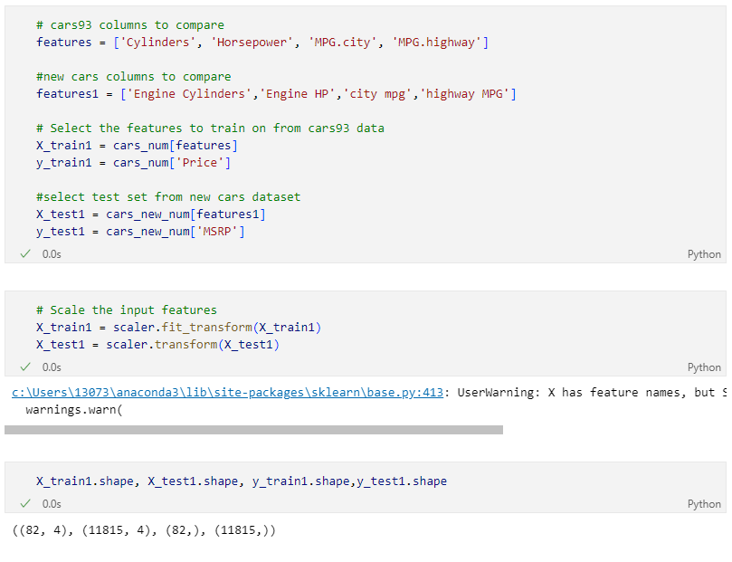
Cars Dataset

Slide 15



Diabetes Dataset
Preprocess → Done Already
Training the models:

Slide 16
Diabetes Dataset Continued
3. Evaluation of the 3 models:
Model | R² → Training | R² → Testing | Mean Squared Error
Linear | 0.5279198995709651 | 0.45260660216173787 | 2900.1732878832318
Ridge | 0.5278462338370481 | 0.4534315003732732 | 2895.802851981438
Lasso | 0.5169420144043178 | 0.47185526169086933 | 2798.190968742363

Slide 17
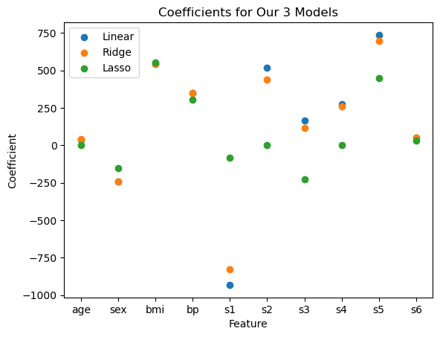
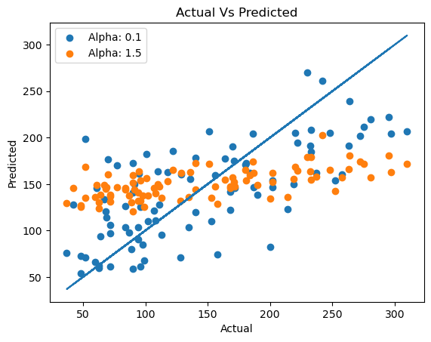
Diabetes Dataset Wrap Up
4. Visualizations

Slide 18
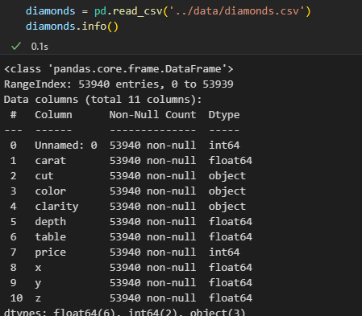
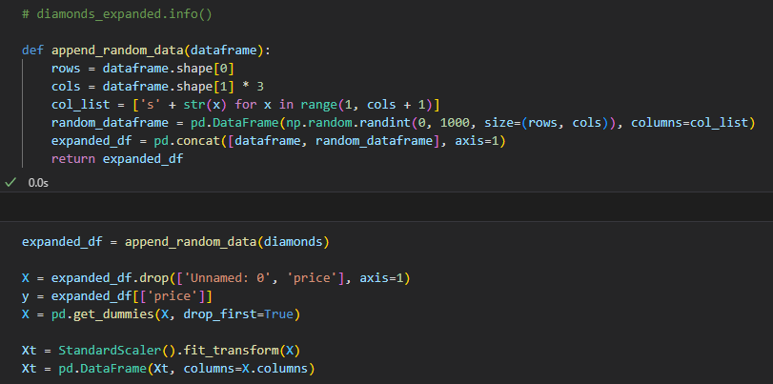
Diamonds Dataset - Intro Code
Notes:
Jesse

Slide 19
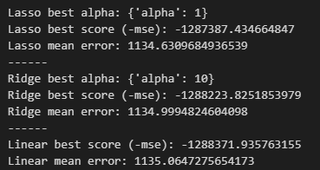
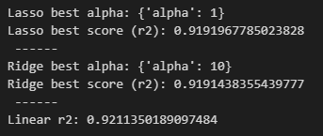

Diamonds Dataset - Findings
Decrease in # of coefficients due to regularization process
Notes:
Jesse

Slide 20
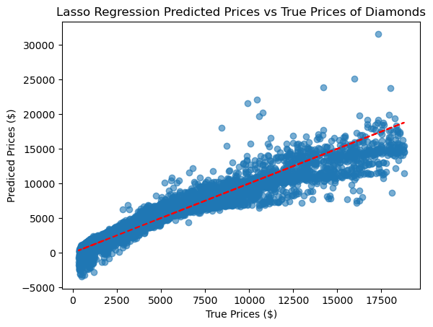

Diamonds Dataset - Prediction Plots
Notes:
Jesse

Slide 21
Resources
Articles
YouTube Videos
https://www.youtube.com/watch?v=uu2X47cSLmM
https://www.youtube.com/watch?v=0yI0-r3Ly40
L1 and L2 Regularization Methods
Regularization in Machine Learning
GridSearchCV documentation
Mean Squared Error or R-Squared?
Ridge Coeffs vs Regularization plot

Slide 22

Thanks!
Questions?
GitHub Link:
https://github.com/jhoffmanDEV10/LassoRidge

Slide 23
Citations
https://towardsdatascience.com/understanding-the-bias-variance-tradeoff-165e6942b229
https://regenerativetoday.com/understanding-regularization-in-plain-language-l1-and-l2-regularization/
https://www.analyticsvidhya.com/blog/2016/01/ridge-lasso-regression-python-complete-tutorial/
https://www.section.io/engineering-education/regularization-to-prevent-overfitting/
https://www.datacamp.com/tutorial/tutorial-lasso-ridge-regression
https://towardsdatascience.com/intuitions-on-l1-and-l2-regularisation-235f2db4c261

Slide 24
Initial Findings
Ridge and Lasso
Ridge and Lasso are both shrinkage/regularization techniques used to prevent the overfitting of data
This prevention is possible as the shrinkage process lowers the impact of high variability on the model
These models are good at addressing multicollinearity, regularization, feature selection, and flexibility
Great to use when predicting a quantity
Performance - for both, this is measured with Mean Squared Error (MSE) - the lower this value, the better the model
Alpha Hyperparameter - the value of the alpha hyperparameter determines how much the coefficients are penalized
As alpha approaches infinity, the coefficient estimates get smaller
Alpha = 0, no penalty is applied and gives the same result as LinearRegression
Shrinkage - reduction in effects of sample variation
Regularization - shrinking of coefficients towards/to 0 to avoid overfitting a model
Ridge
Penalizes the flexibility of a model by shrinking the size of the regression coefficients
Here, alpha is applied to the square of the coefficient (L2 regularization)
The smaller the coefficient, the lower the impact its correlated feature has on the prediction
Doesn’t work very well with a high number of features (thousands-millions)
LASSO (Least Absolute Shrinkage and Selection Operator)
Here, alpha is applied to the absolute value of the coefficient (L1 regularization)
Shrinks coefficients to select the most important features: low importance feature coefficients are reduced to ~0 (negligible values)
Doesn’t work too well with many highly-correlated features

